Slide 1
The Evolution of Data Infrastructure at Linkedin
Lei Gao
http://www.linkedin.com/in/gaolei

Slide 2
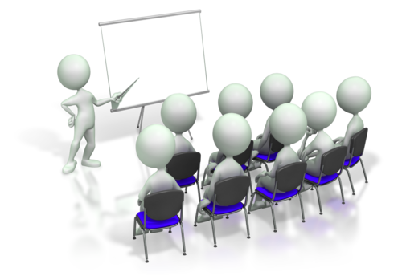
Outline
Company and Mission
Products and Science
Data Infrastructure
Conclusion

Slide 3
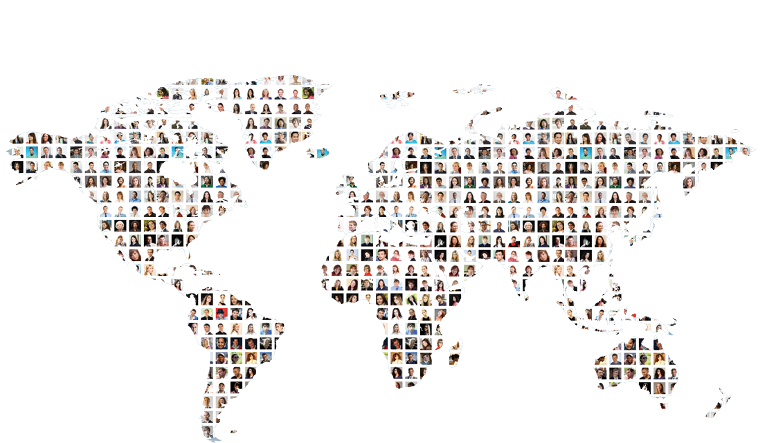
The World’s Largest Professional Network
Connecting the world’s professionals to make them more productive and successful
225M+
2+ new
132M+
2.9M+
Members Worldwide
Members Per Second
Monthly Unique Visitors
Company Pages

Slide 4
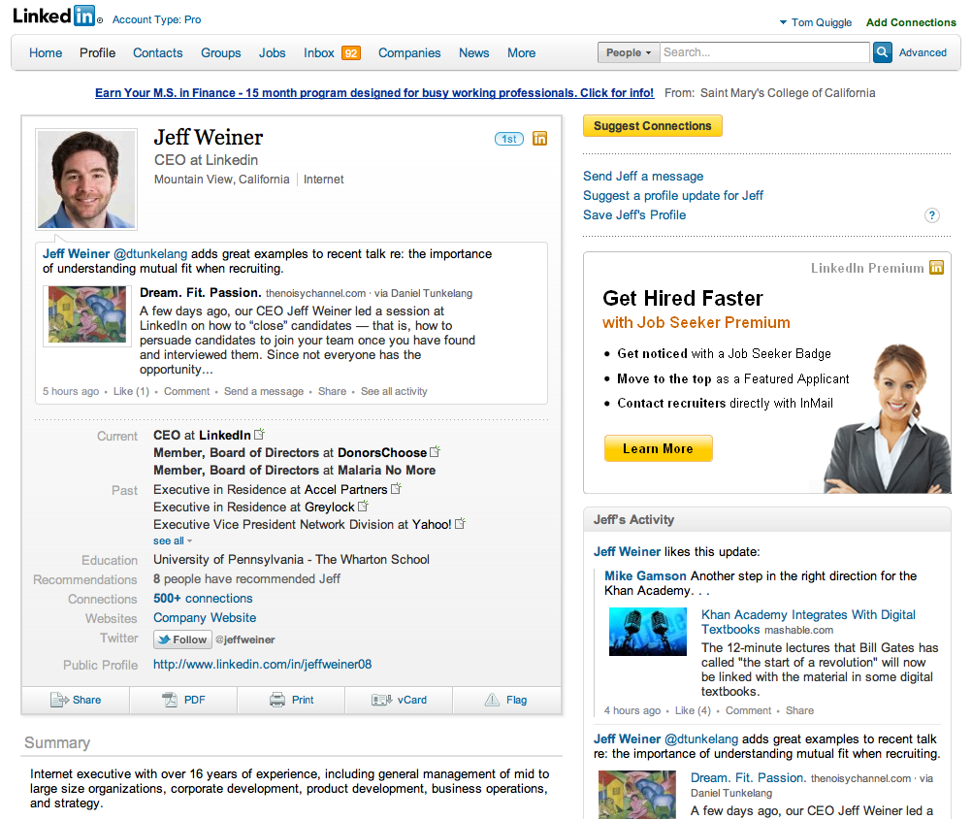
Member Profiles
Large dataset
Medium writes
Very high reads
Freshness <1s

Slide 5
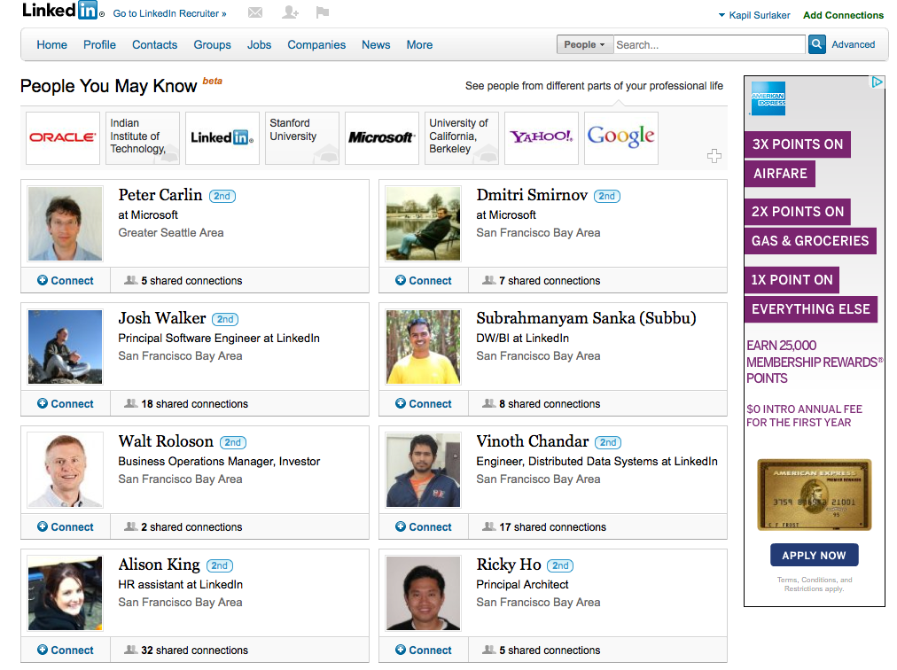
People You May Know
Large dataset
Compute intensive
High reads
Freshness ~hrs

Slide 6
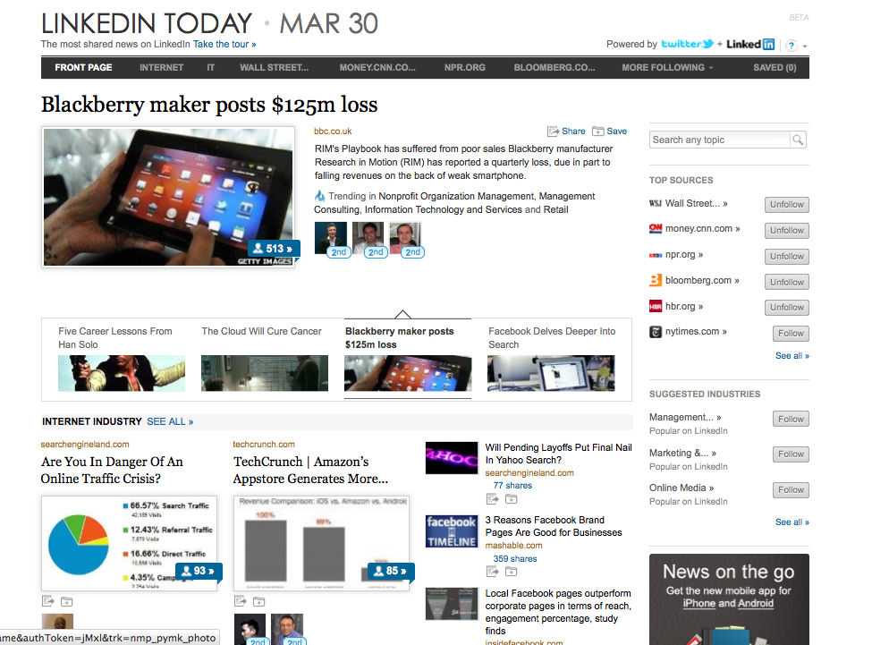
LinkedIn Today
Moving dataset
High writes
High reads
Freshness ~mins

Slide 7
LinkedIn Data Infrastructure: Three-Phase Abstraction
Near-Line Infra
Application
Offline Data Infra
Users
Online Data Infra
Infrastructure
Latency & Freshness Requirements
Products
Member Profiles
Company Profiles
Connections
Messages
Endorsements
Skills
Online
Activity that should be reflected immediately
Activity Streams
Profile Standardization
News
Recommendations
Search
Messages
Near-Line
Activity that should be reflected soon
People You May Know
Connection Strength
News
Recommendations
Next best idea…
Offline
Activity that can be reflected later
Notes:
Transition needs to be good
Products => data infrastructure requirements in previous slide
All products don’t make the same latency and freshness requirements from our data infrastructure
The way we bucketize this is….
News and recommendations show up in both nearline and offline

Slide 8
The Big-Data Feedback Loop
Engagement ↑
Refinement ↑
Value ↑
Member
Product
Virality ↑
Insights ↑
Signals ↑
Data
Science
Scale ↑
Analytics ↑
Infrastructure

Slide 9
LinkedIn Data Infrastructure: Sample Stack
Databus
Infra challenges in 3-phase ecosystem are diverse, complex and specific
Some off-the-shelf.
Significant investment in home-grown, deep and interesting platforms

Slide 10
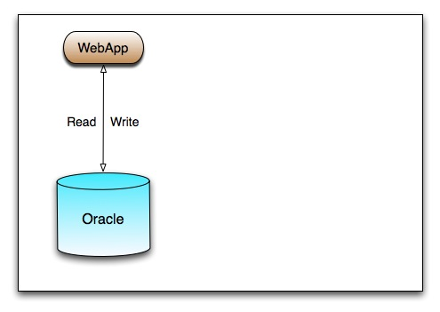
The Original RDBMS Model

Slide 11
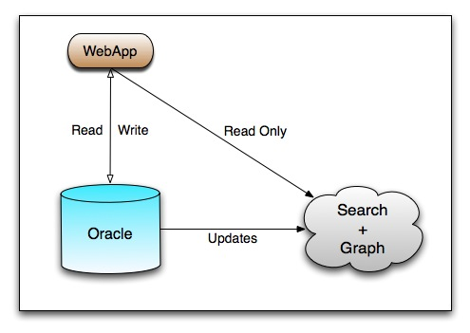
Streaming Transactions for Search/Connections

Slide 12
Databus : Timeline-Consistent Change Data Capture
LinkedIn Data Infrastructure Solutions

Slide 13
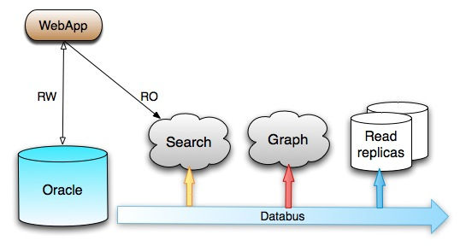
Streaming Transactions for Search/Connections
RO
RO
RO

Slide 14
Databus at LinkedIn
Client
DB
Capture
Changes
Relay
On-line
Changes
Databus Client Lib
Consumer 1
Consumer n
 |  |  | Event Win
On-line
Changes
Compressed
Delta Since T
Bootstrap
Client
Consistent
Snapshot at U
Databus Client Lib
Consumer 1
Consumer n
DB
Transport independent of data source: Oracle, MySQL, …
Transactional semantics
In order, at least once delivery
Tens of relays
Hundreds of sources
Low latency - milliseconds

Slide 15
Scaling Core Databases
RO
RO
RO

Slide 16
Voldemort: Highly-Available Distributed KV Store
LinkedIn Data Infrastructure Solutions

Slide 17
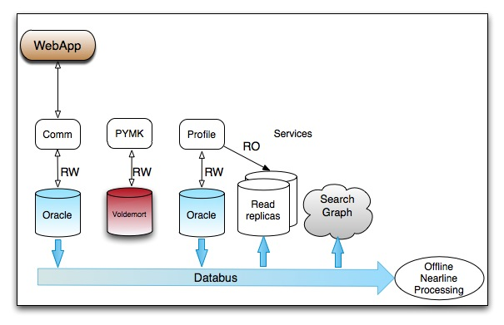
Scaling Core Databases

Slide 18
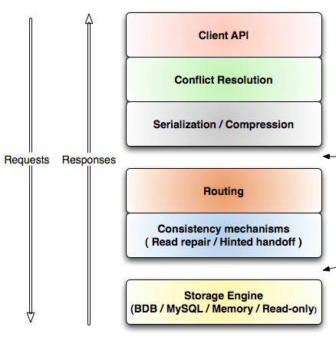
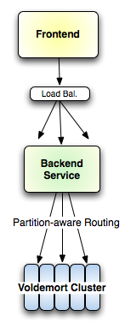
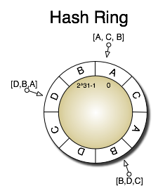
Voldemort: Architecture
Pluggable components
Tunable consistency / availability
Highly scalable key/value store
14 clusters, 400 nodes
400K peak QPS
100TB data
2~3ms avg latency

Slide 19
Scaling Core Databases
Secondary Index

Slide 20
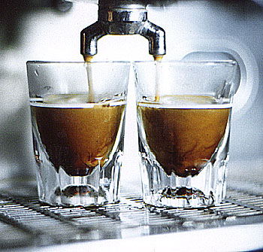
Espresso: Indexed Timeline-Consistent Distributed Data Store
LinkedIn Data Infrastructure Solutions

Slide 21
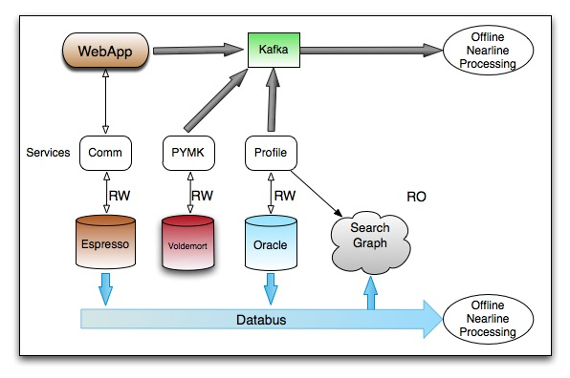
Storage with Richer Data Model
Espresso

Slide 22
Application View
Hierarchical data model
Rich functionality on resources
Conditional updates
Partial updates
Atomic counters
Rich functionality within
resource groups
Transactions
Secondary index
Text search

Slide 23
Espresso: System Components
Partitioning/replication
Timeline consistency
Change propagation

Slide 24
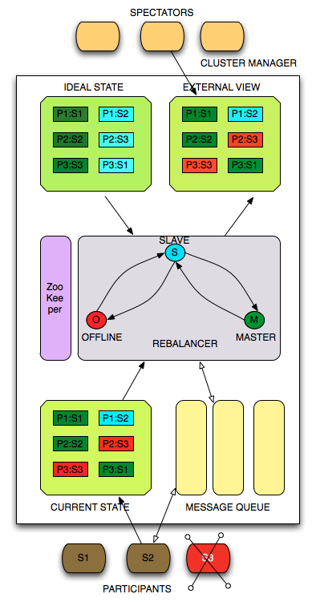
Generic Cluster Manager: Helix
Generic Distributed State Model
Config Management
Automatic Load Balancing
Fault tolerance
Cluster expansion and rebalancing
Espresso, Databus and Search
Open Source Apr 2012
https://github.com/linkedin/helix

Slide 25
Streaming Non-transactional Events
Hadoop/DW
Espresso

Slide 26
Kafka: High-Volume Low-Latency Messaging System
LinkedIn Data Infrastructure Solutions

Slide 27
Ingress – Offline Data Analytics
Secured
Hadoop/DW

Slide 28
Kafka Architecture
Producer
Producer
Key features
Scale-out architecture
High throughput
Automatic load balancing
Intra-cluster replication
Broker 1
Broker 2
Broker 3
Broker 4
topic1-part1
topic1-part2
topic2-part1
topic2-part2
topic2-part2
topic1-part1
topic1-part2
topic2-part1
Per day stats
writes: 10+ billion messages
reads: 50+ billion messages
topic2-part1
topic2-part2
topic1-part1
topic1-part2
Zookeeper
Consumer
Consumer

Slide 29
Egress – Analytics Results for Online Serving
Secured
Hadoop/DW

Slide 30
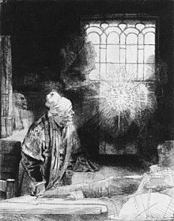
WebHDFS + Faust
LinkedIn Data Infrastructure Solutions
+

Slide 31
Egress – Getting Data Out from Offline
Secured
Hadoop/DW
WebHDFS
Faust
Kafka

Slide 32
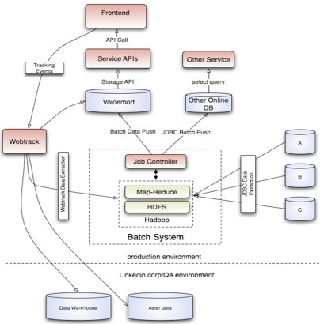
Batch Environment Data Flow

Slide 33
Workflow management: Azkaban

Slide 34
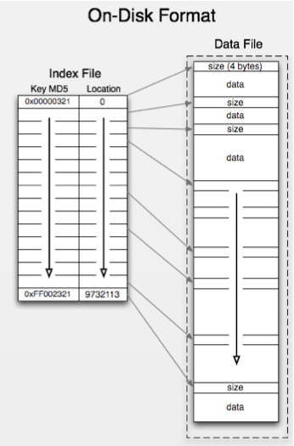
Read-only Data Generation and Transfer
Map-reduce jobs generate RO files
All index fits in memory for fast reads
File system cache for data
Data transferred in parallel via WebHDFS
Authentication always required for each file transfer out of Hadoop

Slide 35
Modifiable Data Generation and Transfer
Monitoring
Throttling
Scheduling
Other Data Sources
Other Data Sources
Plug-ins
Plug-ins
Map-reduce jobs generate records
In Avro format
Annotated key and value fields
Records published from Hadoop to Kakfa
Faust consumes records from Kafka
Faust streams records into Voldemort, Espresso, and other serving platforms
Hadoop
Voldemort
Kafka
Kafka Plug-in
V. Plug-in
Teradata/ DWH
Espresso
Databus Plug-in
E. Plug-in
Faust

Slide 36
Summary
E2E: The Big-Data feedback loop is essential for product design
Infrastructure
Data Infra needs continuous innovation and iteration to scale out
Fast moving, Big, Clean Data + Agile Metadata = Goodness
Data-driven products need agile feedback infrastructure and measurement methodology.
Methodology
Data-Driven experimentation enables insights and agile products
Recommendation-driven products have big impact.
Read more @ data.linkedin.com
Notes:
Key Recommendation Problems
Content Analysis and Feature Extraction over unstructured and semi-structured content
Entity Disambiguation (e.g. Title = Web Janitor, Company = IBM)
Entity to Entity Matching (M-M causes n^2 e.g. Similar Profiles asked for by Recruiters and PYMK) Entity = {Member, Skills, Jobs, Group, Company, Activity, …} . (ANIMATION later?)
Blending and Ranking of Heterogeneous Content (e.g. NUS, Group Disc, Job Posting)
Key Optimization Problems
Response Prediction (e.g. Sponsored Content tradeoff between Relevance and User Response)
Multi-Objective Optimization (e.g. Ads, Talent Match – show best candidates + high-propensity-switch-cand to job poster and to high-prop)
Audience and Inventory Forecast (e.g. for Ads, Experiments;

Slide 37
Help us. Come Have Fun with Us!
Science and Data Mining: Recommendation and Optimization Problems
Next-generation ad-hoc and OLAP query processing on Hadoop
Graph Computations: Off-line mining and On-line integration loops
nRT Data Streams in Near-line infrastructure
And much more…
Info: data.linkedin.com
Notes:
Key Recommendation Problems
Content Analysis and Feature Extraction over unstructured and semi-structured content
Entity Disambiguation (e.g. Title = Web Janitor, Company = IBM)
Entity to Entity Matching (M-M causes n^2 e.g. Similar Profiles asked for by Recruiters and PYMK) Entity = {Member, Skills, Jobs, Group, Company, Activity, …} . (ANIMATION later?)
Blending and Ranking of Heterogeneous Content (e.g. NUS, Group Disc, Job Posting)
Key Optimization Problems
Response Prediction (e.g. Sponsored Content tradeoff between Relevance and User Response)
Multi-Objective Optimization (e.g. Ads, Talent Match – show best candidates + high-propensity-switch-cand to job poster and to high-prop)
Audience and Inventory Forecast (e.g. for Ads, Experiments;

Slide 38
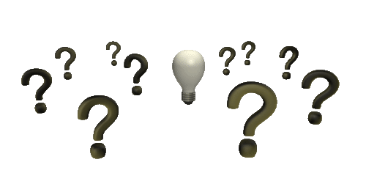
In Closing
lgao@linkedin.com
Thank You!

