Slide 1
Web Accessibility
Office of the Government Chief Information Officer
Digital Inclusion Divison
27 June 2013

Slide 2
What is Web Accessibility?
Making web Content available for ALL
ALL people of the community
Including persons with disabilities (361,000 about 5.2% of total Hong Kong population)

Slide 3
Why Web Accessibility?
Corporate
Social
Responsibility

Slide 4
W3C International Guideline
https://www.hkirc.hk/dmp/2013/about_speakers.html
https://www.hkirc.hk/dmp/2013/about_speakers.html
Web Content Accessibility Guideline WCAG 2.0
- Four Principles
Content is Perceivable
User interface components and navigation are Operable
Information and operation are Understandable
Content is Robust enough to be interpreted reliably by web browsers, assistive technologies…

Slide 5
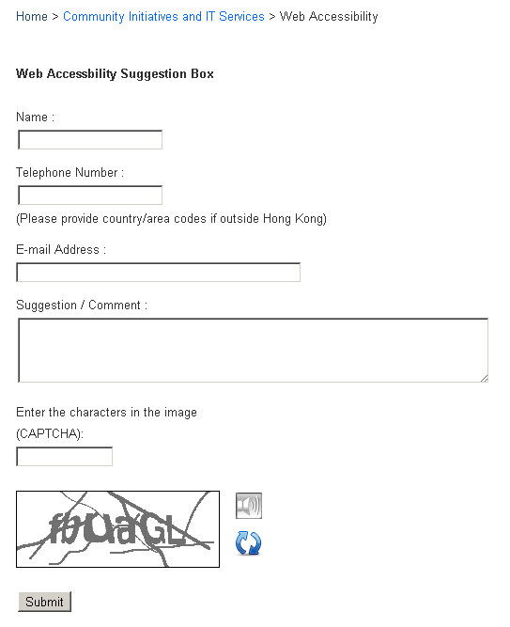
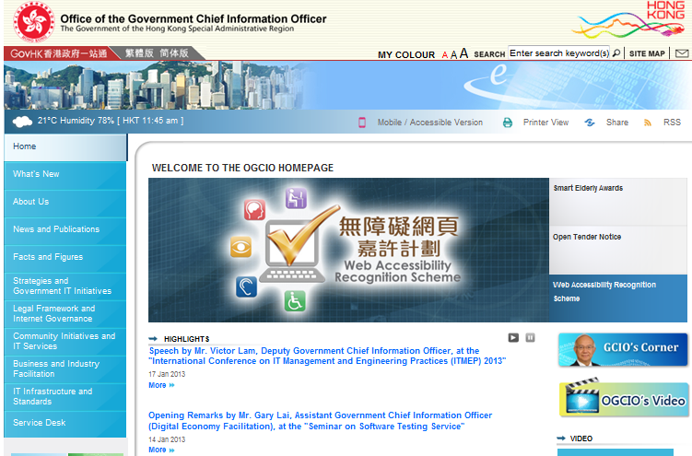
WCAG 2.0 - Principles
1 - Perceivable
Example - Audio CAPTCHA
2 - Operable
Example - Provide users enough time to read and use content
Provide Pause Function
Audio Support
www.ogcio.gov.hk

Slide 6
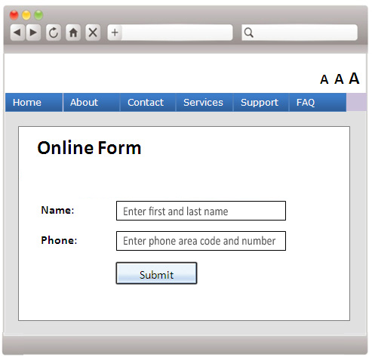
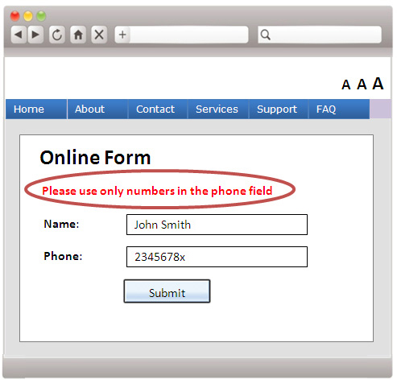
WCAG 2.0 - Principles
3 - Understandable
Example – Clear label with cue and error identification
4 - Robust
Compatibility with browsers
Input Assistance
Error
Identification

Slide 7
Government Policy
One of five key areas of 2008 Digital 21 Strategy
- Building an inclusive, knowledge-based society
bring the benefit of ICT to needy groups
enhance their quality of life
strengthen their capacity in engaging with the development of information society

Slide 8
Government Policy
OGCIO launched Web Accessibility Campaign in October 2011
To facilitate access to online information and services for all segments of the community including persons with disabilities
To promote wider adoption of web accessibility design in both public and private sectors

Slide 9
Web Accessibility Campaign
Government Leadership
Fostering Awareness
Promulgating Resources
Building Expertise
Encouraging Adoption
Conformance of Websites to W3C WCAG Level AA
Promotion to Public Sector Network
Talks /
Seminars / Workshops
Resource Development
Empower-ment
Assessment and Advisory Service
Recognition Scheme
Government Policy
Appeal Letter by FS
Public Organisations
Webforall Portal
Curriculum Development in Institutions
Websites Assessment
Accreditation
Experience Sharing with Departments
Survey on Adoption Status
Private Organisations/ Commerce Chambers
Management Handbook
Advisory Coaching
Advisory Service
Publicity of Awarded Websites
Advisory Coaching
NGOs and Social Services Orgs
Facilitation of Sourcing Service Providers
ICT Companies and Practitioners
Accessible Webpage Templates & Developers’ Guide
Tertiary Students
Reference Cases
Special Schools

Slide 10
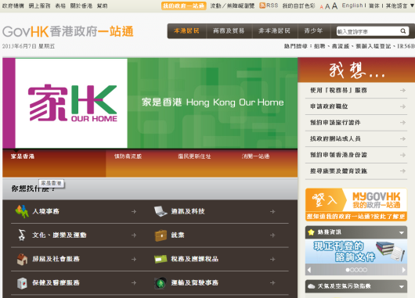
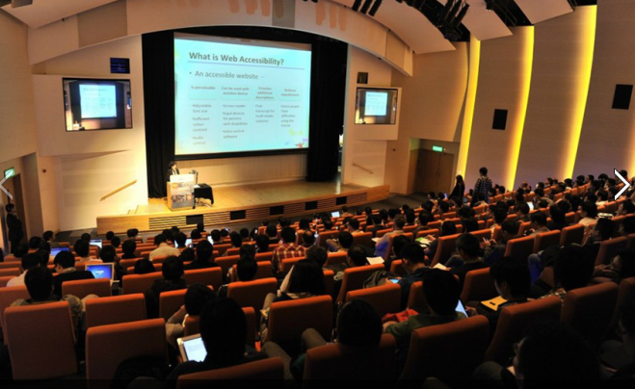
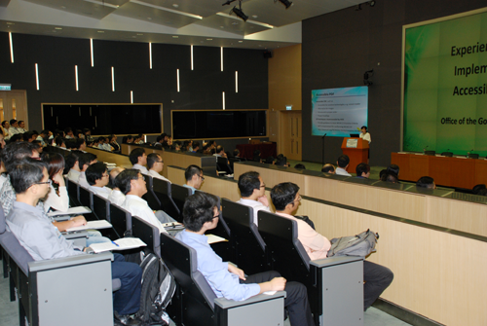
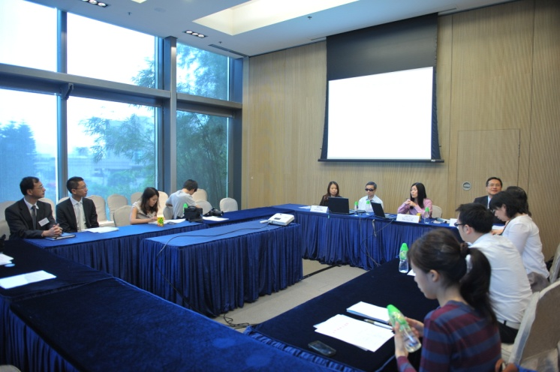
Web Accessibility Campaign
Government Leadership
Fostering Awareness
Government Leaders
Fostering Awareness
Government Websites
Seminars & Workshops
Public-sector organisations
Over 3000 participants

Slide 11
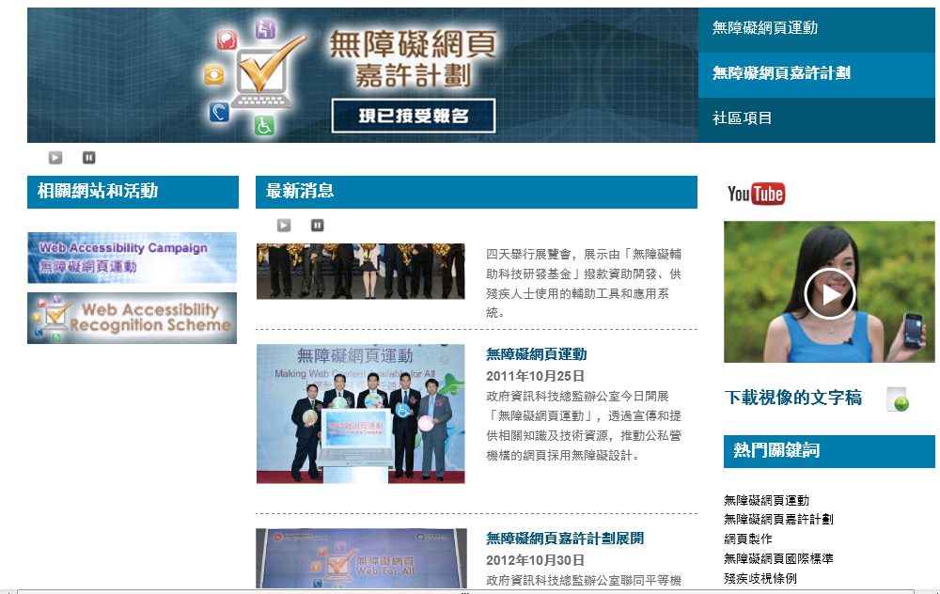
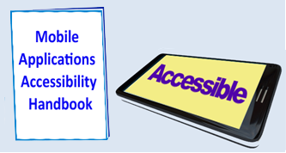
Web Accessibility Campaign
Promulgating Resources
Promulgating Resources
Accessible Webpage Templates
Webforall Portal
www.webforall.gov.hk
Mobile Applications
Accessibility Handbook

Slide 12
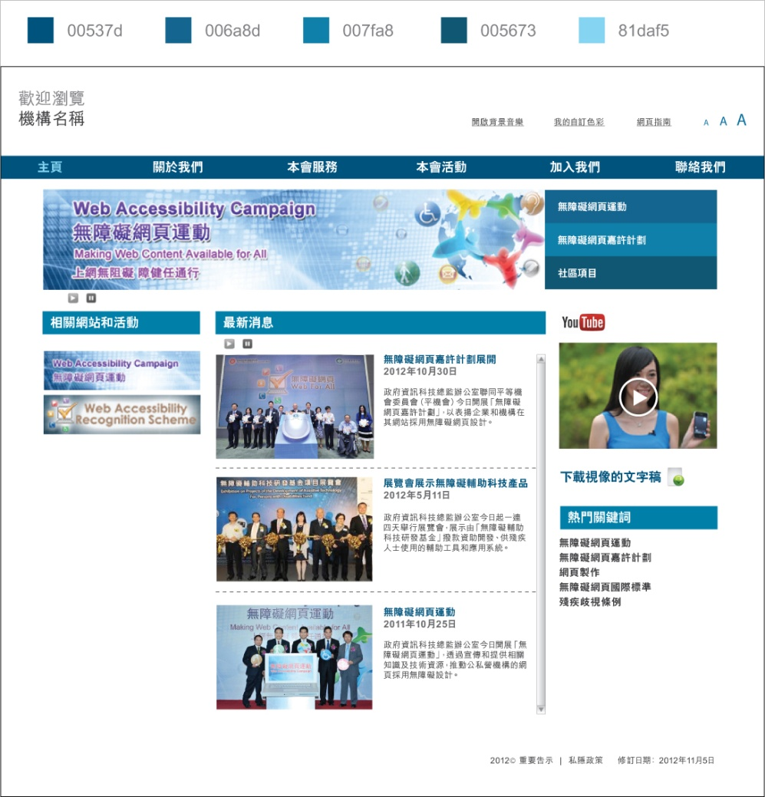
Accessible Webpage Templates
For NGOs or SMEs to build barrier-free websites
Sample codes incorporated with essential web accessibility features, e.g.
4. Provide User-initiated background audio
1. Provide “Skip To Content”
5. Allow text resize
2. Provide meaningful alt text for images
6. Provide keyboard accessible menu
7. Provide embedded video channel
3. Allow to play or pause the auto-scrolling latest news
8. Provide sufficient colour contrast

Slide 13
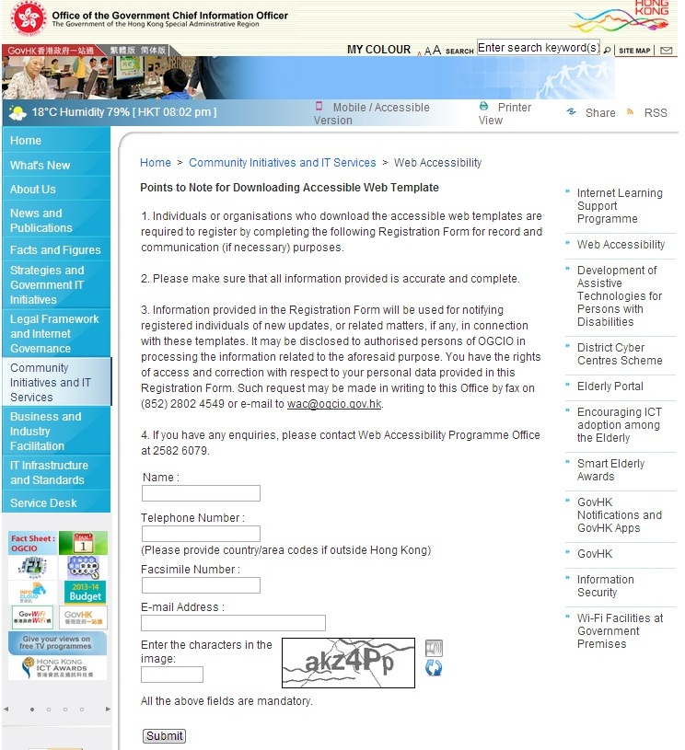
Accessible Webpage Templates
Free Download
www.webforall.gov.hk/web_template.htm
Please provide your contact details in the form and submit it

Slide 14
Web Accessibility Campaign
Building Expertise
Building Expertise
Incorporate Web Accessibility into ICT curricula

Slide 15
Web Accessibility Campaign
Encouraging Adoption
Encouraging Adoption
Web Accessibility Recognition Scheme
Reference to International standard
Criteria verified by persons with disabilities
Free assessment and advisory services
Grant Webforall accreditation logos

Slide 16
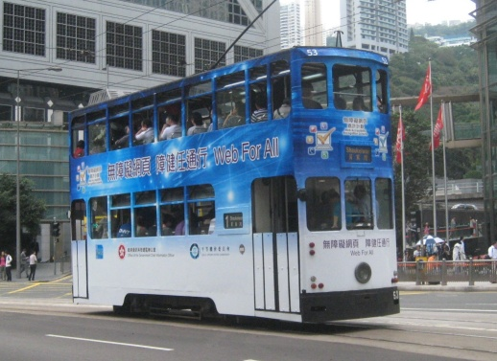
Web Accessibility Recognition Scheme
Recognition Scheme 2013
香港聾人福利促進會
The Hong Kong Society for the Deaf
44 Gold Awards and 26 Silver Awards

Slide 17
Web Accessibility Recognition Scheme
Recognition Scheme 2014
Co-organise with Equal Opportunities Commission
Website / Mobile Apps^{NEW!} streams
http://www.
Awards Presentation Ceremony in April 2014
Details to be announced in webforall portal -
www.webforall.gov.hk/recognition_scheme

Slide 18
Your Support to Web Accessibility
Adopt web accessibility for websites/mobile apps
Ensure colleagues and content providers are aware of the importance and having relevant skills
Encourage clients/business partners to do the same
Download and use Accessible Webpage Templates
Enrol Web Accessibility Recognition Scheme 2014
Webforall

Slide 19
Enquiry
Web Accessibility Programme Office
Email address : wac@ogcio.gov.hk
Telephone no. : 2582 6079
Website : www.webforall.gov.hk

Slide 20
Let’s join hands in making a caring and inclusive society
Thank you!

